Slide 1
Digital Portfolio
STUDENT NAME: PRATHAP.P
REGISTER NO AND NMID: 2426j6005 & asbru312326j1543
DEPARTMENT: B.Sc IT
COLLEGE: Cheran Arts Science College

Slide 2
PROJECT TITLE
Mood Tracker Pro

Slide 3


AGENDA
Problem Statement
Project Overview
End Users
Tools and Technologies
Portfolio design and Layout
Features and Functionality
Results and Screenshots
Conclusion
Github Link
3/21/2024 Annual Review

Slide 4

PROBLEM STATEMENT
🎯 Problem Statement
Many people struggle to recognize emotional patterns or triggers in their daily lives. Without consistent tracking, it's hard to identify trends that affect mental health. Mood Tracker Pro solves this by offering:
- A quick way to log moods
- A calendar-based history viewer
- A weekly mood chart for visual insights

Slide 5
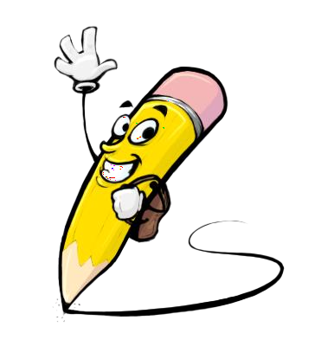
PROJECT OVERVIEW
🧠 Project Overview
Mood Tracker Pro is a responsive web application designed to help users monitor their emotional well-being. By logging daily moods and notes, users can visualize patterns over time using interactive charts. This tool promotes self-awareness and mental health reflection in a simple, elegant interface.

Slide 6

WHO ARE THE END USERS?
1. Individuals Practicing Self-Care
2. Students & Young Adults
3. Remote Workers & Professionals
4. Therapy Clients
5. Mental Health Advocates & Coaches

Slide 7

TOOLS AND TECHNIQUES
🛠 Technologies Used
- HTML5: Semantic structure
- CSS3: Responsive styling and layout
- JavaScript (ES6): DOM manipulation, local storage, chart rendering
- Chart.js: Data visualization

Slide 8
POTFOLIO DESIGN AND LAYOUT
Minimalist Developer Portfolio
Clean white background with bold typography.
Hero section with name, tagline, and tech stack icons.
Project cards with screenshots, descriptions, and GitHub links.
Footer with contact info and social media badges.
Creative Designer Portfolio
Vibrant color palette with animated transitions.
Full-width hero image and catchy intro text.
Grid layout showcasing design projects with hover effects.
Embedded Behance/Dribbble links and a styled contact form.
‹#›

Slide 9
FEATURES AND FUNCTIONALITY
Features
- Emoji-based mood logging
- Daily notes
- Calendar-based history
- Weekly mood chart
- Local storage (no backend required)
🧭 Future Enhancements
- 🔐 User authentication (Firebase or Supabase)
- ☁ Cloud sync across devices
- 📊 Toggle between bar and pie charts
- 📤 Export mood history to CSV or PDF
- 📱 Native mobile app version (React Native or Flutter)

Slide 10
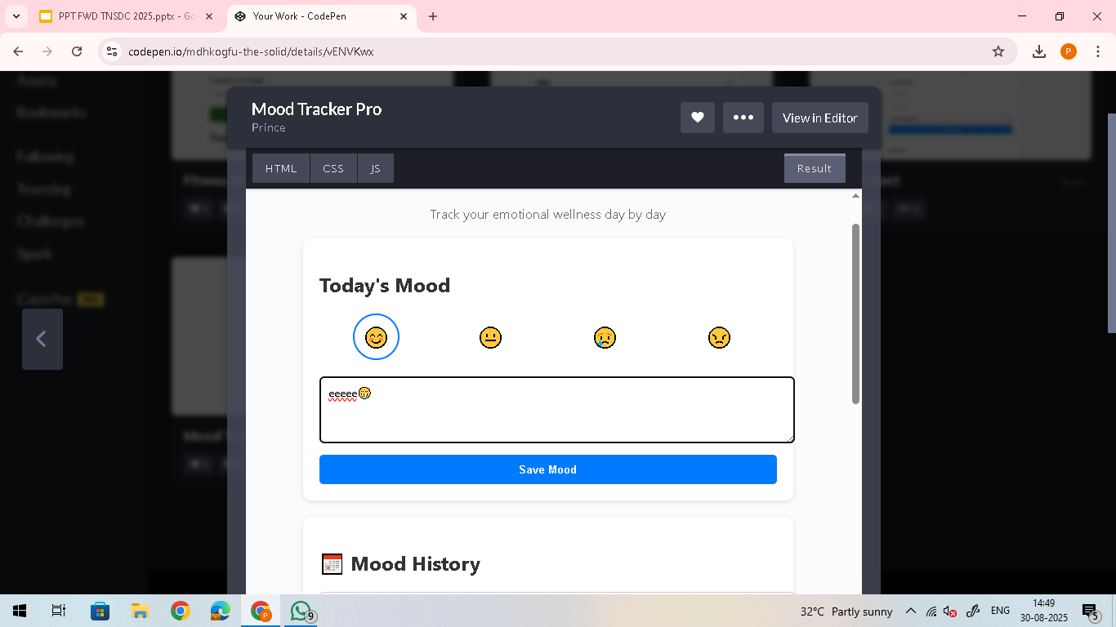

RESULTS AND SCREENSHOTS
3/21/2024 Annual Review
‹#›

Slide 11
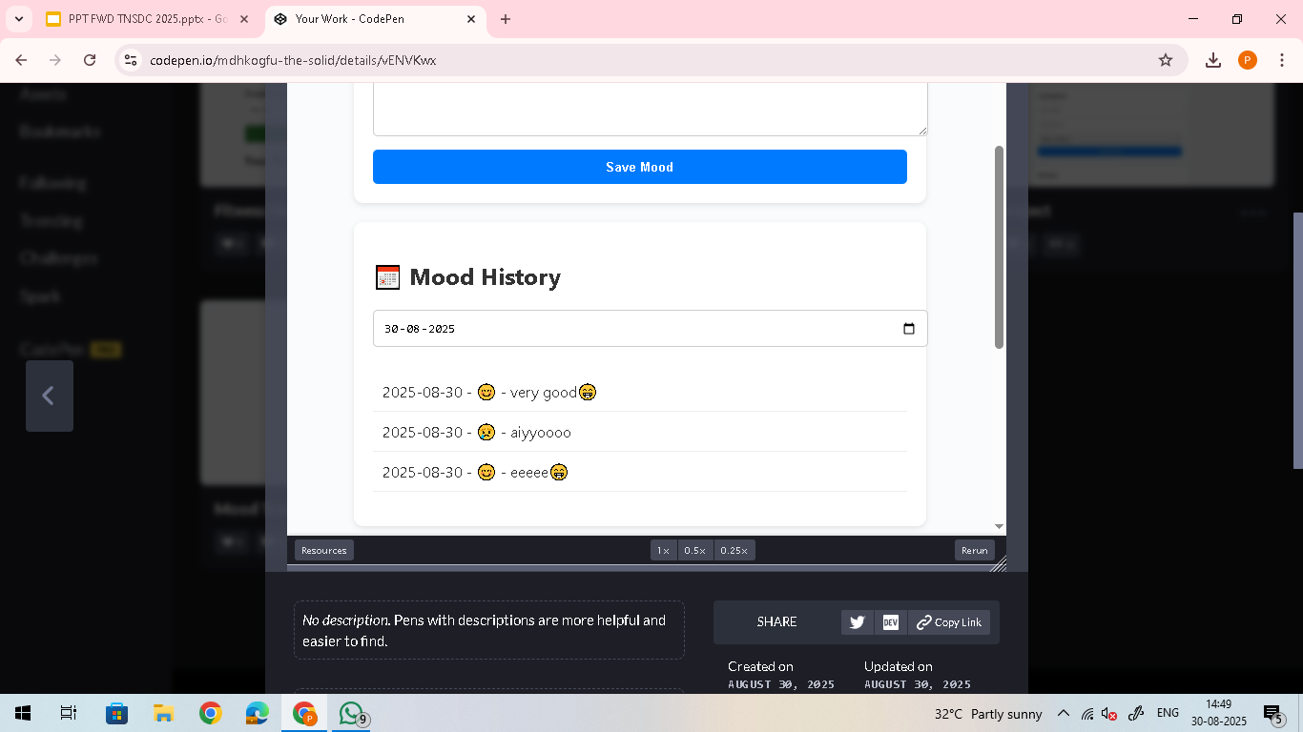
RESULTS AND SCREENSHOTS
3/21/2024 Annual Review
‹#›

Slide 12
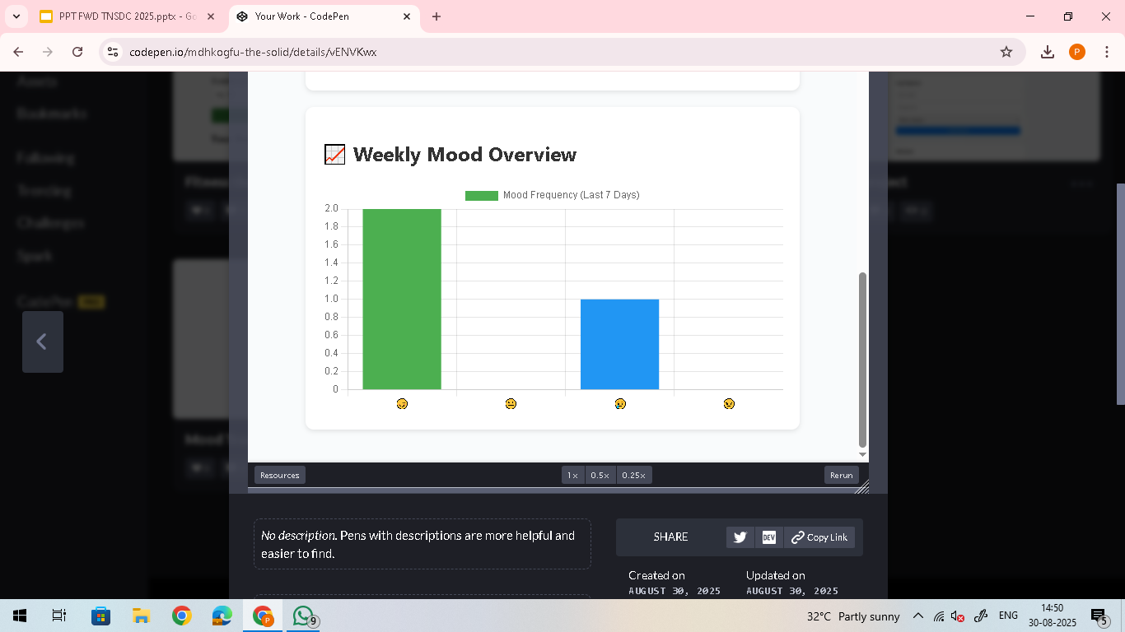
RESULTS AND SCREENSHOTS
3/21/2024 Annual Review
‹#›

Slide 13
CONCLUSION
A well-designed portfolio is more than just a showcase — it's your personal brand in action. By combining clean layout, thoughtful visuals, and clear storytelling, you create a lasting impression that speaks to your skills and creativity. Whether minimalist or bold, the key is to make it authentically yours.
‹#›

